Slide 1
Progressing the Industrial Strategy Sam Lister Director of Industrial Strategy 27 March 2019

Slide 2
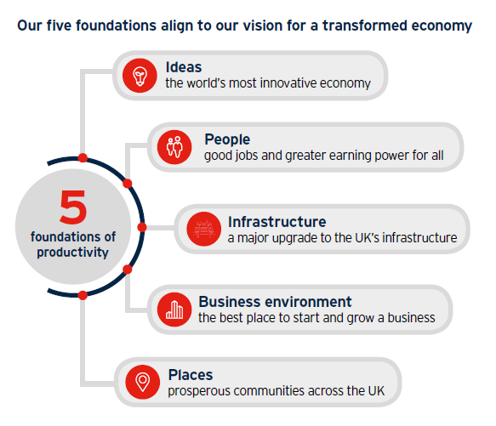
Industrial Strategy – our ambitions
Our Industrial Strategy sets out a long-term plan to boost productivity by backing businesses to create good jobs and increase the earning power of people throughout the United Kingdom.
Foundations – strengthening the fundamentals of productivity.
Sector Deals – building long-term partnerships between business and the Government.
Grand Challenges – taking on the society-changing opportunities and industries of the future.
AI & Data
We will put the UK at the forefront of the artificial intelligence and data revolution
Clean Growth
We will maximise the advantages for UK industry from the global shift to clean growth
Ageing Society
We will harness the power of innovation to help the needs of an ageing society
Future of Mobility
We will become a world leader in the way people, goods and services move

Slide 3
Making a difference across the UK
While many of the Industrial Strategy’s commitments are high impact over the long-term, there have already been important signals of progress towards our commitments. These include:
£7bn record increase in public R&D investment by 2021/22. Private sector R&D spend up 5%; research jobs up 7%.
More than 80 policy announcements and milestones have been met over the last year. Examples of particular relevance to rural economy include:
Funding for University of Essex agricultural productivity programme through the Strength in Places Fund.
Full fibre broadband connections in hard to reach areas through UK-wide £200m Rural Gigabit Connectivity programme.
Business support to SMEs including information on access to access to finance, and wide consultation engagement.
Local Industrial Strategies to provide distinctive and long-term visions of how places in England will maximise their contribution to UK productivity.
Apprenticeships adapted to the needs of business – over 270 new standards have already been approved across all sectors.
47k people started higher level apprenticeships. Published the ‘Good Work Plan’, following the Taylor Review.
Housing Infrastructure Fund commits to supporting housing developments capable of delivering 650k homes.
82k smaller business supported by the British Business Bank. #1 for venture capital in Europe.
Rapid development of local industrial strategies. 18 cities benefitting from £2.5bn for intracity transport.

Slide 4
Priorities for 2019
Key commitments for the year ahead include:
Launch an R&D roadmap to set out how public, private and voluntary sectors will meet the 2.4% target.
AI & Data: Roll out budget-backed AI4Gov Review which will spur public and private sector AI adoption.
Roll out of Institutes of Technology. Driving continued growth in higher-level apprenticeships.
Ageing Society: Publish a new Green Paper outlining our plans to deliver five extra healthy independent years of life for all.
Address UK’s top infrastructure priorities, responding to National Infrastructure Commission.
Future of Mobility: Respond to changes in technology and trends with both an urban and rural strategies for changes in transportation.
Introduce new programmes to help improve the productivity of 5.7m British businesses.
Clean Growth: Launch design competition for ‘Home of the Future’, key to buildings mission; publish Green Finance Strategy.
Support areas to produce Local Industrial Strategies. Agree framework for Shared Prosperity Fund.
This month we published the Offshore Wind Sector Deal. Others in negotiation include Food & Drink Manufacturing and Tourism.

Slide 5
Engagement on key rural issues
The Industrial Strategy wants to ensure the UK fully realises the economic opportunities offered by the rural parts of the country.
Programme of workshops over the last two years – helping focus minds on the key considerations:
Respect for rural as an equal partner in the future economy;
Connectivity – both physical and technological;
Young people and skills – workforce retention, training and retraining;
Business support – for the numbers of business, types & sectoral diversity;
Devolution – increased opportunities and empowerment for areas.
Important scrutiny to keep us to task, including from:
Parliament – such as the Lords Select Committee on the rural economy;
Industrial Strategy Council – importance of productivity, pay and place.
Notes:
1) Rural areas contribute £246 billion (16.4% of England’s economy).
Lower capital investment per employee in predominantly rural areas - London was around £6,500, compared with £5,300 in predominantly urban areas excluding London, and £5,100 in predominantly rural areas.
2) £37bn NPIF - Rural businesses face challenges – rural areas are more dispersed and benefit less from agglomeration effects; digital connectivity and transport links.
3) Big question going into the SR – the big challenge (biggest in SR?); what barriers, smaller pool of skilled labour on which to draw. Role of SAPs.
4) Number: 0.5m businesses registered in rural areas;
employ 3.5 million people (13%);
more firms per capita in rural areas than in urban areas, and proportionally more SMEs (72% vs 41%)
Diversity -15% of registered businesses, 7.7% of people employed and approx. 2% of productivity (GVA) is attributable the agriculture, fisheries and forestry sectors in rural areas.
5) At NPH discussion –
Emma Bridgewater – campaign for protection of rural England.

Slide 6
Questions for today
Some considerations for the workshop:
How can rural areas benefit from and take part in Grand Challenges?
How should rural economies best implement the Industrial Strategy at a local level (in both England and Devolved Nations)?
What could support / facilitate the most productive engagement with the UK Government?
And an action for all of us to take away…

